Slide 1

Computer Law & Investigation
Evidence Analysis 2

Slide 2

Lim Mong Seng v PP
Chief Justice Yong Pung How:
“The pervasive role played by computers in today’s society and the increase in computerisation of records will no doubt lead to more and more computer output being presented in evidence.”

Slide 3
Sections 35 & 36 of Evidence Act
Previously, the admission of computer output evidence is found in sections 35 and 36 of the Evidence Act. They were introduced in 1996. Computer technology was then in its infancy.
A cautious approach was therefore taken. Short of agreement between parties, computer output can be admitted only if:
it is produced in an approved process; or
it is shown to be produced by a properly operating computer which was properly used.
Notes:
Sounds a little circular, but it does make sense. Further, documents in the form of electronic records will be treated as primary evidence.

Slide 4
REPEAL of sections 35 & 36 of EA
This is a somewhat cumbersome process and not consonant with modern realities.
With the benefit of experience, the position now is that computer output evidence should not be treated differently from other evidence.
Sections 35 and 36 are therefore repealed.
Notes:
Sounds a little circular, but it does make sense. Further, documents in the form of electronic records will be treated as primary evidence.

Slide 5

Sections 35 & 36 of EA
Evidence of computer output
35. —(1) Unless otherwise provided in any other written law, where computer output is tendered in evidence for any purpose whatsoever, such output shall be admissible if it is relevant or otherwise admissible according to the other provisions of this Act or any other written law, and it is —
(a) expressly agreed between the parties to the proceedings at any time that neither its authenticity nor the accuracy of its contents are disputed;
(b) produced in an approved process; or
(c) shown by the party tendering such output that —
(i) there is no reasonable ground for believing that the output is inaccurate because of improper use of the computer and that no reason exists to doubt or suspect the truth or reliability of the output; and
(ii) there is reasonable ground to believe that at all material times the computer was operating properly, or if not, that in any respect in which it was not operating properly or out of operation, the accuracy of the output was not affected by such circumstances. [8/96]
Notes:
Sounds a little circular, but it does make sense. Further, documents in the form of electronic records will be treated as primary evidence.

Slide 6
Presumptions in relation to electronic records
In addition, there will be new presumptions facilitating the admission of electronic records - introduced by the Evidence (Amendment) Act 2012.
For example, where a device is one that, if properly used, accurately communicates an electronic record, it will be presumed that an electronic record communicated by that device was accurately communicated (s 116A(1) EA)
Notes:
Sounds a little circular, but it does make sense. Further, documents in the form of electronic records will be treated as primary evidence.

Slide 7
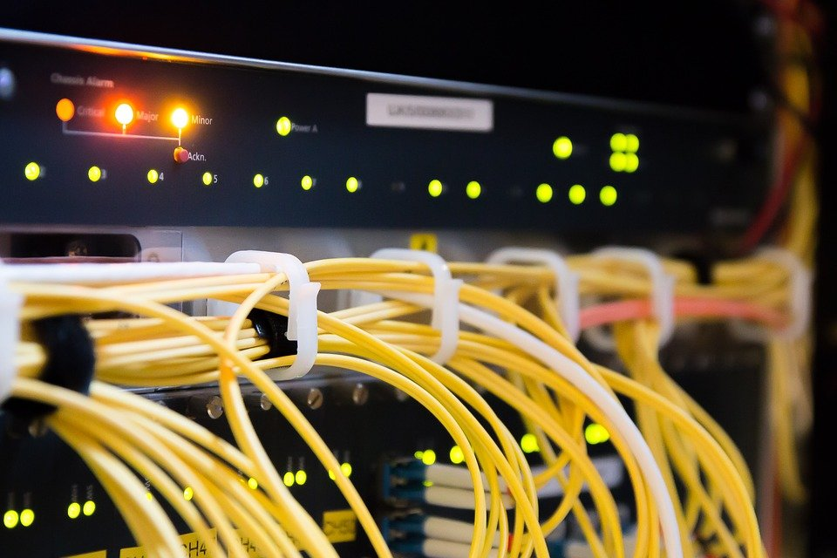
Presumptions in relation to electronic records (for electronic device or process)
116A(1) EA
Illustration.
A seeks to adduce (ie offer in court) evidence in the form of an electronic record or document produced by an electronic device or process.
A proves to the court that the electronic device/process is of a kind that if properly used, ordinarily produces the electronic record/document. This is a relevant fact for the court to presume that in producing the record, the electronic device/process did produce the electronic record/document which A seeks to adduce.

Slide 8

Presumptions in relation to electronic records
Telemedia Pacific Group Ltd v Credit Agricole (Suisse) SA (2015) 1 SLR 338
Case involving the unauthorized transfer of 225 million shares.
Plaintiff (bank’s customer) objected to the reliability of certain electronic records received from the defendant bank on the basis that defendant bank had not adduced evidence to prove that the relevant computer system or devices/processes were properly used.
Court rejected plaintiff’s objection as the evidence presented established that defendant’s system ordinarily produced and accurately communicated information of its customers’ instructions. This was sufficient to trigger the presumption concerning production and accurate communication – s. 116A(1) EA.

Slide 9
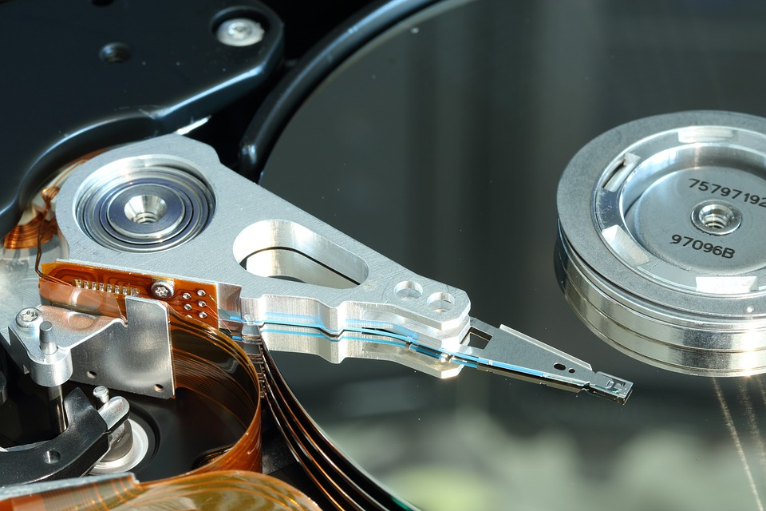
Presumptions in relation to electronic records (as against 3rd Party)
S116A(2) EA
Unless evidence to the contrary is adduced, the court shall presume that any electronic record generated, recorded or stored is authentic if it is established that the electronic record was generated etc. in the usual and ordinary course of business by a person who was not a party to the proceedings and did not generate etc. under the control of the party seeking to introduce the electronic record.

Slide 10

Presumptions in relation to electronic records
Illustration :
A seeks to adduce evidence against B in the form of an electronic record. The fact that the electronic record was generated, recorded or stored in the usual and ordinary course of business by C, a neutral third party, is a relevant fact for the court to presume that the electronic record is authentic.

Slide 11
Processes for Validating Electronic Record are themselves Relevant Facts
S. 9 of Evidence Act: Facts necessary to explain or introduce relevant facts are themselves relevant
This means that the processes for validating (ie; testing the authenticity) an electronic record are themselves relevant facts.

Slide 12
S. 9 (g) of Evidence Act
Illustration
A seeks to adduce evidence against B in the form of an electronic record. The method and manner in which the electronic record was generated, communicated, received or stored (by A or B), the reliability of the devices and the circumstances in which the devices were used or operated to generate, communicate, receive or store the electronic record, all these may be relevant facts as going towards authenticating the electronic record.

Slide 13
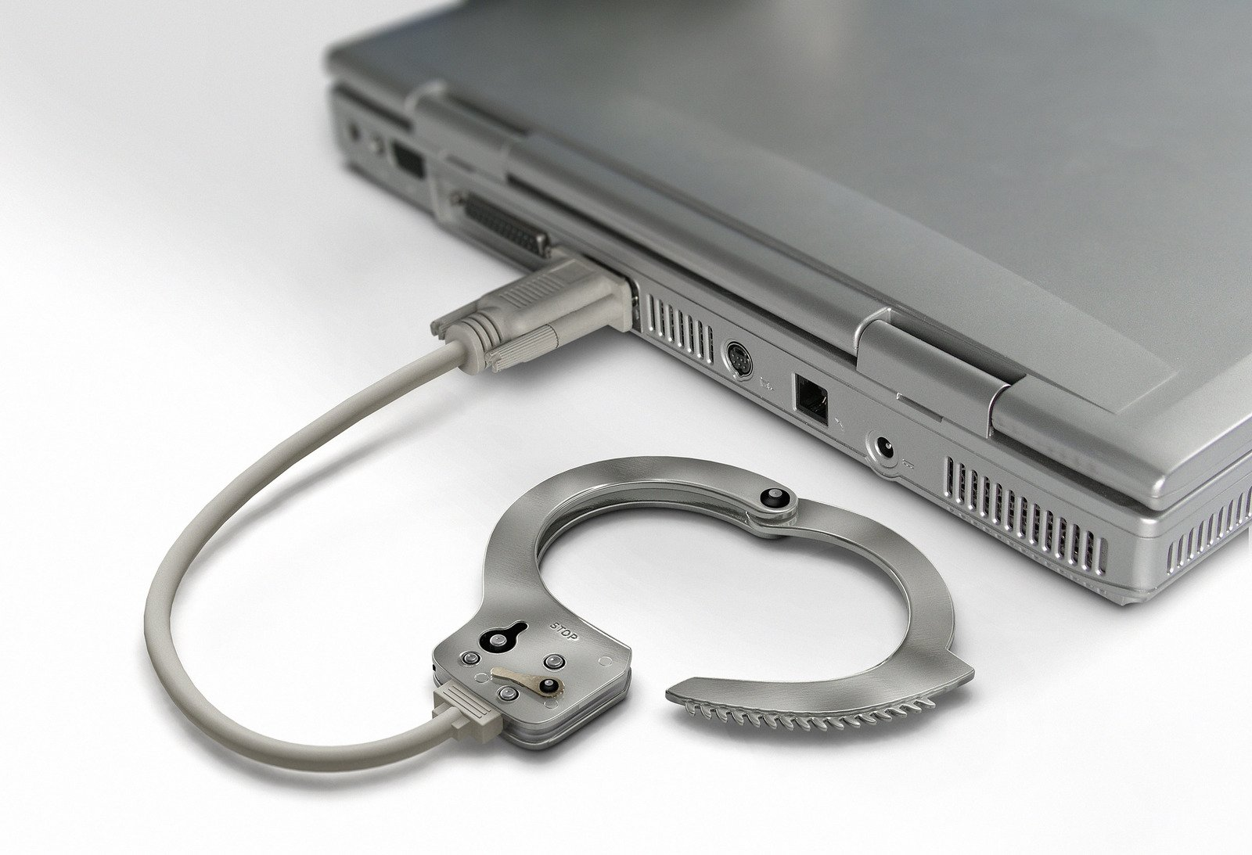
Evidence Analysis
What we need to know-
Where the evidence is
What the evidence means
How to put it together

Slide 14
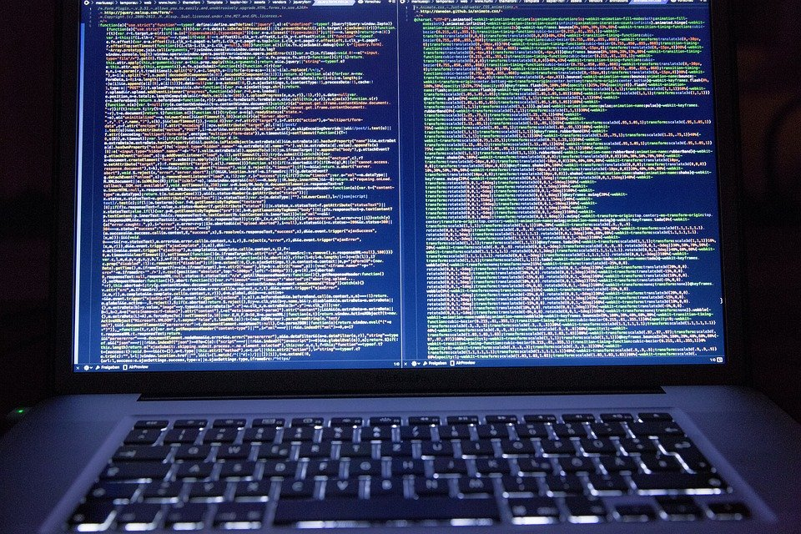
Sources of Evidence
Three basic sources:
  Users
  Systems (including backups)
  Networks/communications
Basically we rely on logs recovered from a compromised system
Notes:
Sources of evidence fall into 3 broad categories:
first person (direct) evidence of witnesses including documentary evidence such as written logs etc.
host based evidence , which includes logs and artifacts from compromised systems and data retrieved from the suspect’s computer (once seized)
network based evidence, which includes things like telephone call records, router logs, monitoring logs etc

Slide 15
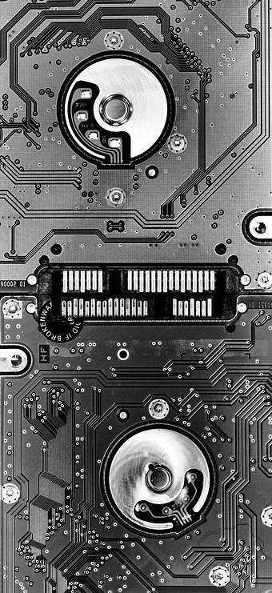
Sources of Evidence
Users
  First hand observations
Systems
  Log files!
  Intruder remnants (processes, files etc)
Networks/communications
  NetFlow Logs
  Firewall logs
  Modem banks/telephone logs
Notes:
Sources of evidence fall into 3 broad categories:
first person (direct) evidence of witnesses including documentary evidence such as written logs etc.
host based evidence , which includes logs and artifacts from compromised systems and data retrieved from the suspect’s computer (once seized)
network based evidence, which includes things like telephone call records, router logs, monitoring logs etc

Slide 16

Mutable Evidence
(ie prone to change)
Computer evidence is endlessly changeable
  An intruder might add/remove/modify log entries
  They might compromise system components that maintain the logs
  You might modify something during your investigation
Forensic procedures help us:
Protect against accidental modification
Show that the copies we have made are faithful to the originals
Show that the copies have not been modified since they were created
We correlate evidence from multiple sources together to discover missing or modified evidence and lend credibility to our analysis.
Notes:
Forensic procedures help us:
Protect against accidental modification
Show that the copies we have made are faithful to the originals
Show that the copies have not been modified since they were created
We correlate evidence from multiple sources together to discover missing or modified evidence and lend credibility to our analysis.

Slide 17
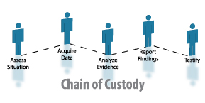
Chain Of Custody
Who has had access to the evidence?
What procedures did they follow in working with the evidence?
How can we show that our analysis is based on copies that are identical to the original evidence?
Answer: documentation, timestamps

Slide 18
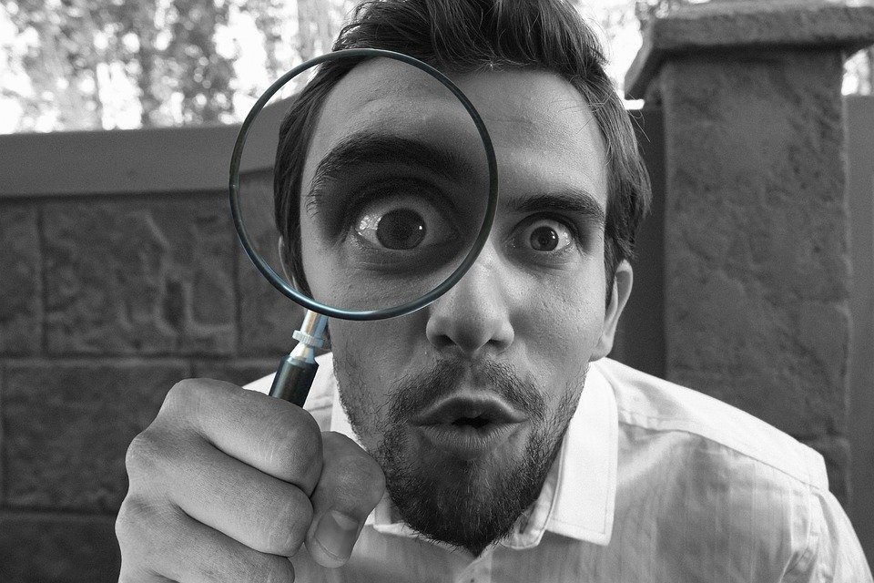
Important Four Steps
To obtain computer related evidence, four steps need to be undertaken, these are:
  Identify the evidence
  Preserve the evidence
  Analyse the evidence
  Present the evidence

Slide 19
The Four Steps
Identify the evidence
  Must identify the type of information that is available
  Determine how to best retrieve it
Preserve the evidence
  With the least amount of change possible
  You must be able to account for any changes made

Slide 20
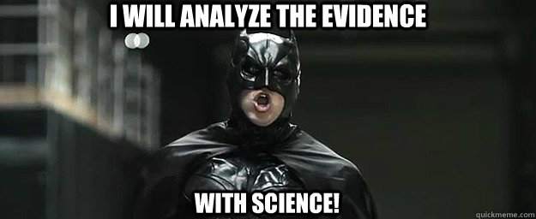
The Four Steps
Analyze the evidence
  Extract, process, interpret
    Extract - may produce binary 'gunk' that isn't human readable
    Process - make it humanly readable
    Interpret - requires a deeper understanding of how things fit together
Photo by: http://www.quickmeme.com/meme/3omtys

Slide 21

The Four Steps
Present the evidence
  To management, lawyers, in Court, etc.
  Acceptance of the evidence will depend on -
    Manner of presentation (did you make it understandable, convincing?)
    The qualifications of the presenter
    The credibility of the processes used to preserve and analyze the evidence
  Especially important when presenting evidence in court
Notes:
Re: qualifications – how can you convince your audience that you know enough about the technology at hand to accurately identify, preserve and analyze the evidence AND critique alternate theories that attempt to account for the evidence?
Re: credibility: Evidence will be questioned. How can you prove that you analyzed an accurate copy of what existed at the time the evidence was collected? It pays to pay attention to details, like documentation and the chain of evidence.
Re: duplication: someone else should be able to take your notes and a copy of the evidence and find the facts that you found.

Slide 22

Evidence Preservation
Of the 4 steps, let’s take a closer look at evidence preservation…

Slide 23
Evidence Preservation
Make a copy
  Generate a copy
  Verify accuracy of copy through timestamp
Document
  Who collected it from where, how, when, why?
Give a copy (or the original) to the custodian
  Custodian gives copies to others
  Document chain of custody
  Fewer custodians is better – fewer to testify that way
Notes:
You might consider making a copy of the software you used for writing/reading your copies, if its something strange.
You don’t want to be caught unable to read the copy you made because you don’t have the right software!

Slide 24
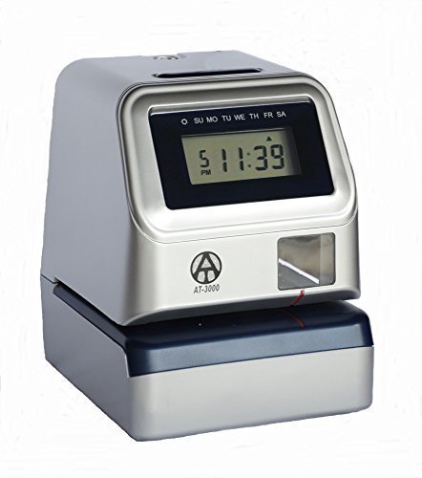
Evidence Preservation
Digital Time stamping
  http://www.itconsult.co.uk/stamper.htm - free service
  http://www.surety.com - commercial
Photo by: https://tinyurl.com/y8ztduqc

Slide 25
The “Best Evidence” Rule
The famous quote of Lord Harwicke in describing this rule states “the judges…..of the law have laid it down that there is but one general rule of evidence, that is the best that the nature of the case will allow”.
  Thus where there was nothing better, the court will resort to admitting evidence which would otherwise be inadmissible in other cases
  This could also mean conversely that the rule may apply to cases in which evidence is excluded because better evidence was available

Slide 26

Best Evidence
For computer output as evidence, the best evidence in decreasing order of desirability are:
  The original disk (but not always possible or physically practical to get original or evidence too volatile)
  A binary copy of the original disk
  A log file from the disk (e.g. UNIX wtmp)
  Records from within a file
  Contents of a file
  A collection of files
  A collection of files with attributes intact
Notes:
It isn’t always possible or practical to take the originals – they might be part of a production system, might be physically impractical, evidence might be too volatile, etc. That’s why we often work with copies, and especially copies of disks. More on this later.
It should be noted that the utility of the notes depends on the credibility of the witness who recorded the notes.

Slide 27

Best Evidence
Example - A byte stream image of the disk is good for most purposes, but not all purposes

Slide 28
End of Lecture

